Slide 1
Microgravity Press Washing Machine 2026

Slide 2
Goals of Presentation
Overview of Working Principle and Background
Design Evolution
Current Design

Slide 3
Please Interject With Questions or Comments
Let me know if you think the design does not seem suitable for space applications for any reason!
If NASA isn’t going to want to use something like this for an aspect of how the design works inherently, I would like to know before building it/developing it more!

Slide 4
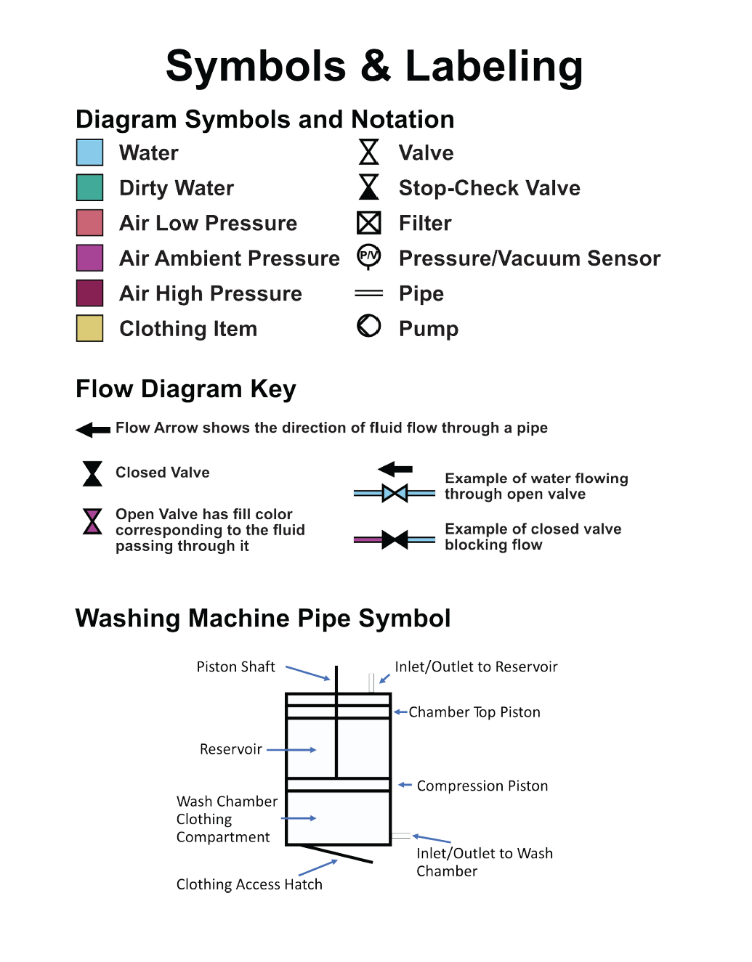
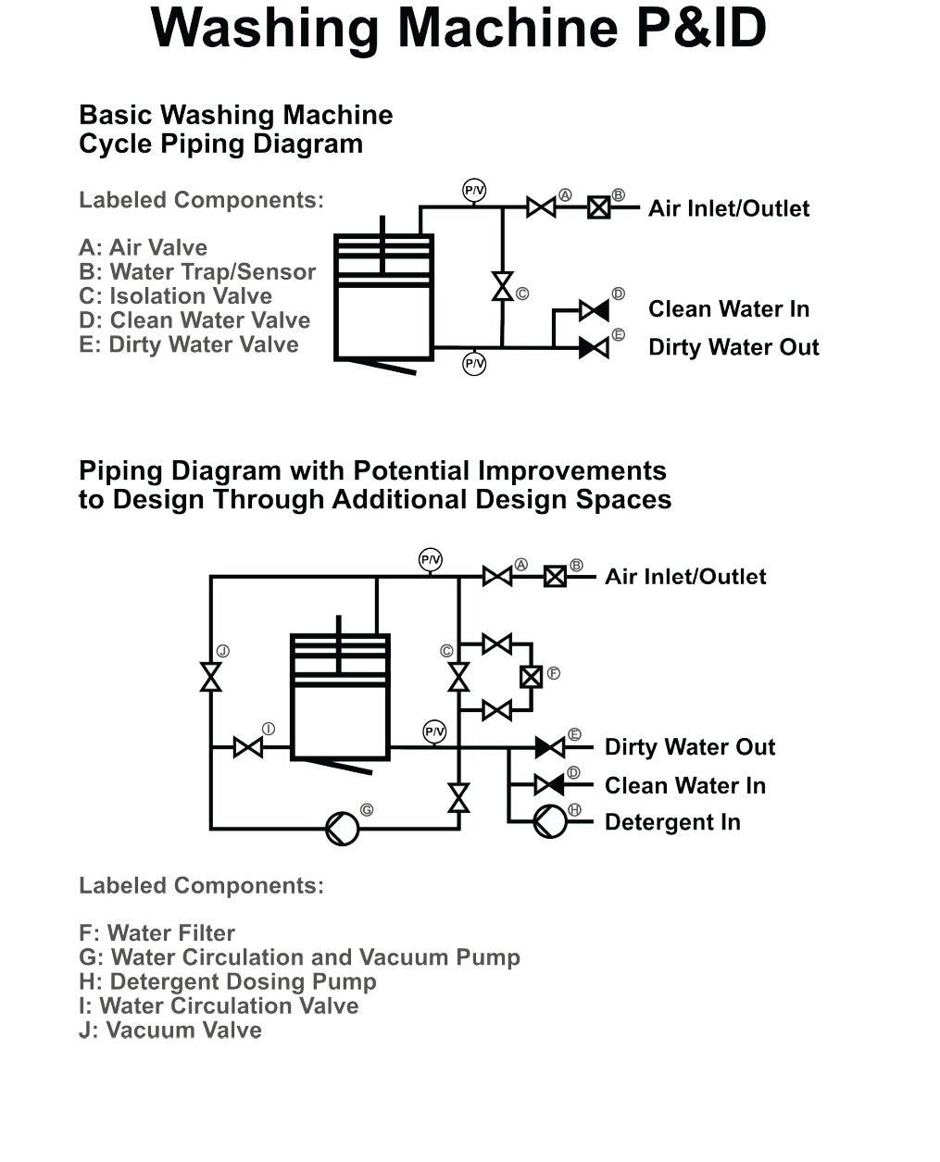
Principles of Old Design

Slide 5
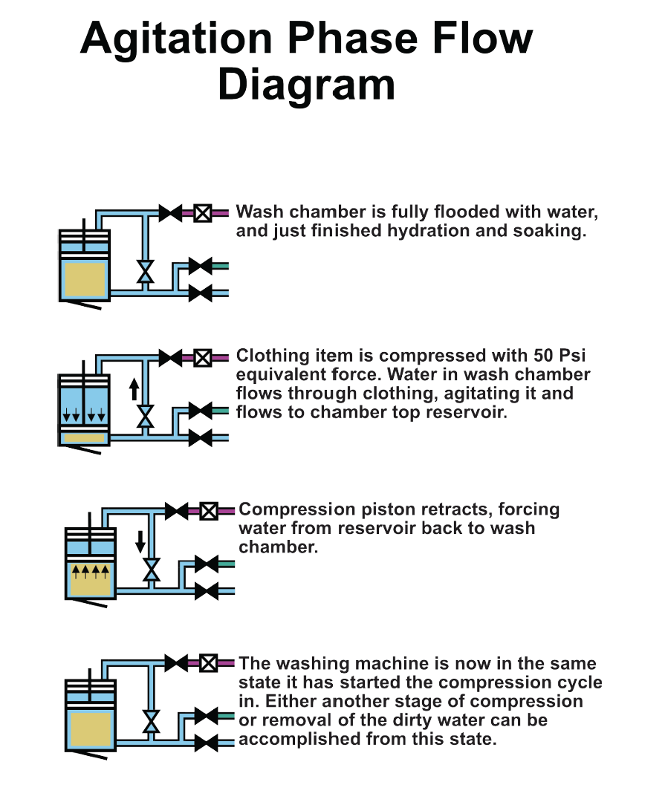
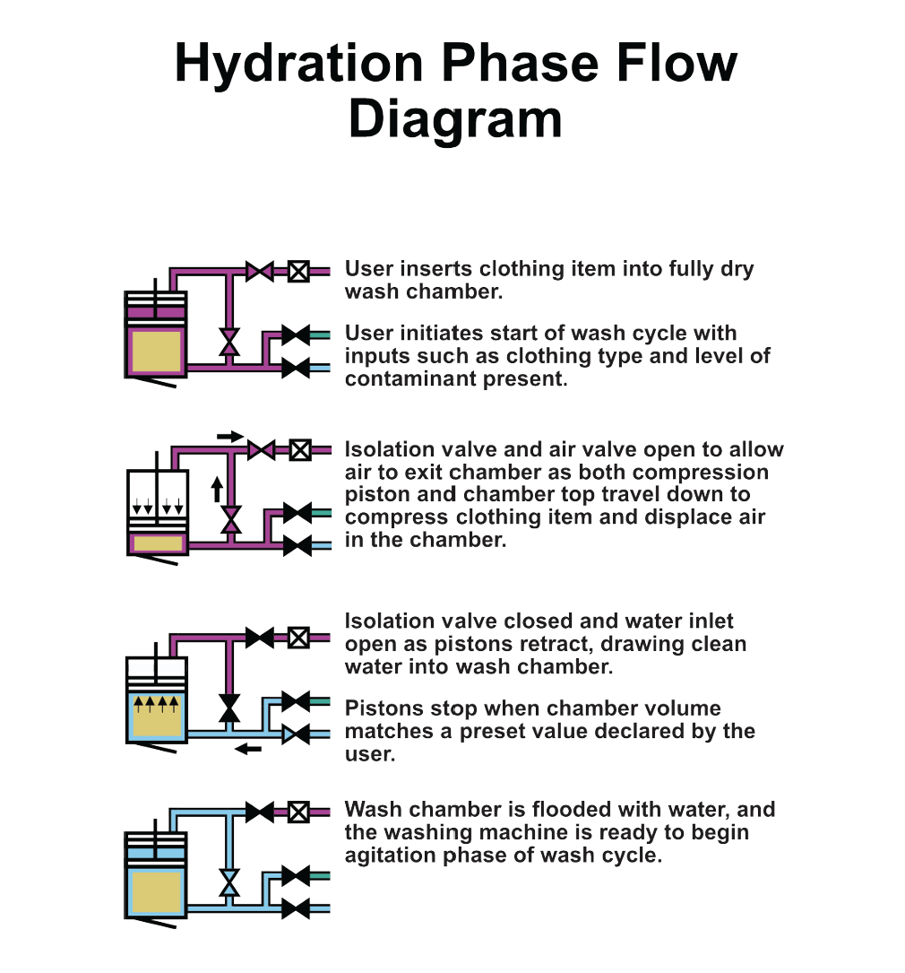
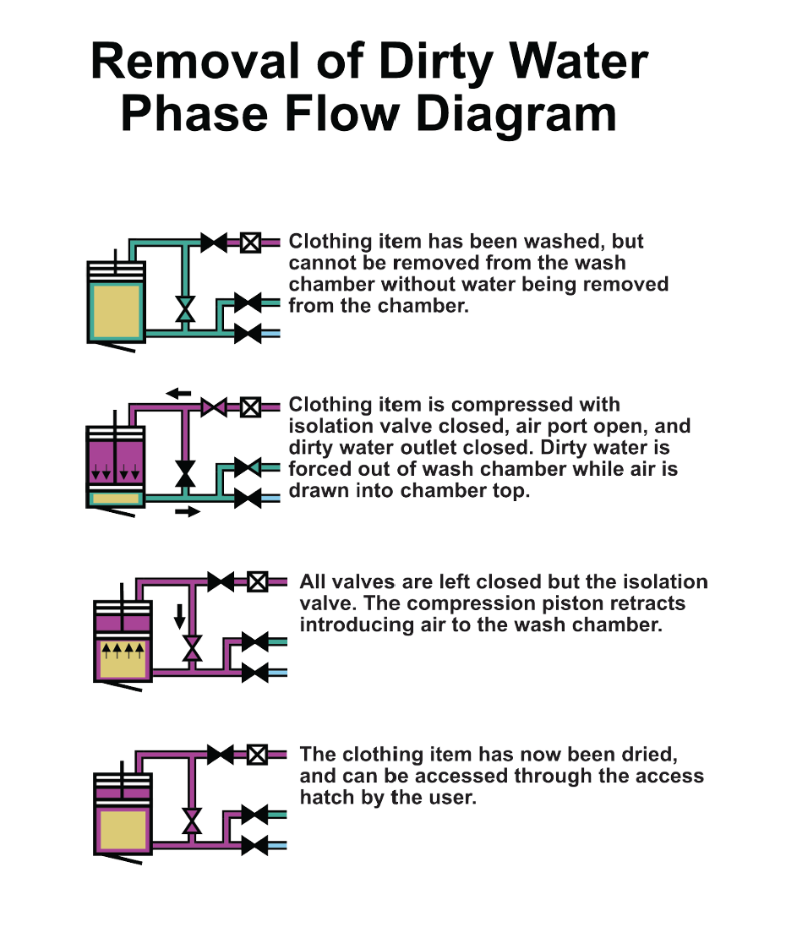
Operation of Old Design

Slide 6
Background – Clothing Volume
Loosely Packed Volume: Space taken up by clothing item uncompressed. Convenient chamber volume for a user to place clothing in wash chamber.
True Volume: How much water would the clothing displace?
Compressed Volume: Space taken by clothing item when compressed to maximum
Vc – Vt = max extractable water by compression

Slide 7
Agitation Mechanism Findings
From previous prototypes, testing showed that agitation by displacing water was not particularly good until compression was above 400 lbf (~30 psi on 4” dia piston)
This is probably because at this pressure, folds on clothing compress to where water must flow through fibers of clothing in order to flow out of chamber.

Slide 8
Important Details of Design
Fluid Pressure is not high. Fluid is displaced and flows freely around clothing item.
Think about what the air pressure around a compressed spring is, ambient!
This holds true as long as flow is low and resistance to flow is minimal. This is a slowish process!

Slide 9
Wash Process Expected Capabilities
Design would be good at removing dissolvable and liquid contaminants.
Likely not suitable for handling regolith without adding more components/would need more research.
For a planetary mission, a suitable washing machine would likely be more like a modern industrial washing machine, though this design might be useful during transit when listed design requirements are applicable

Slide 10
Advantages
Design can do everything in the wash process. hydration, agitation, and removal of dirty water.
Fluid separation maintained, free surface interface problems limited
Wash water consumption is adjustable as needed. Minimum or higher water usage can be used to discretion of user/mission requirements

Slide 11
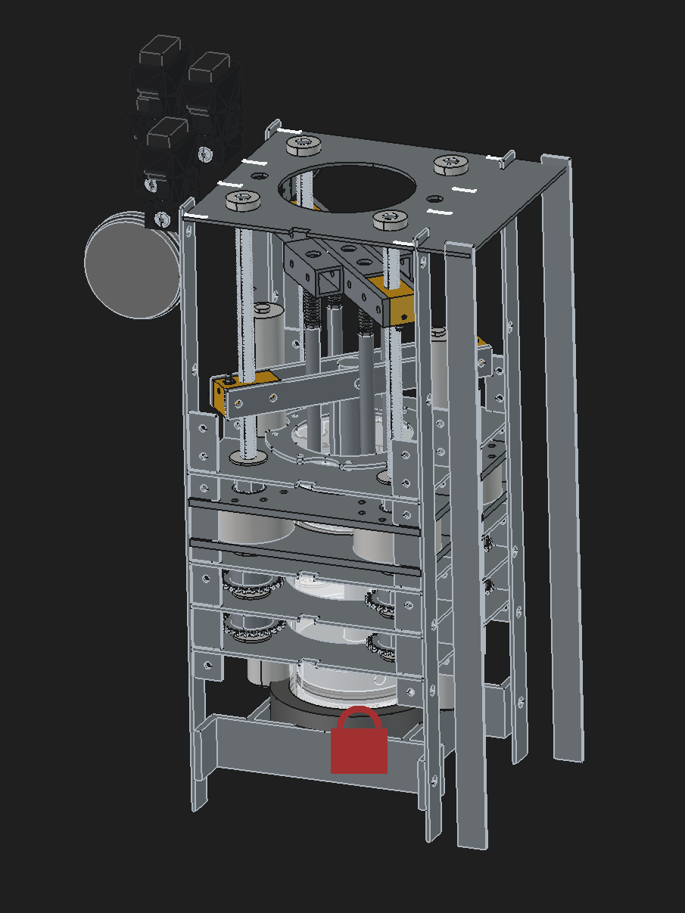
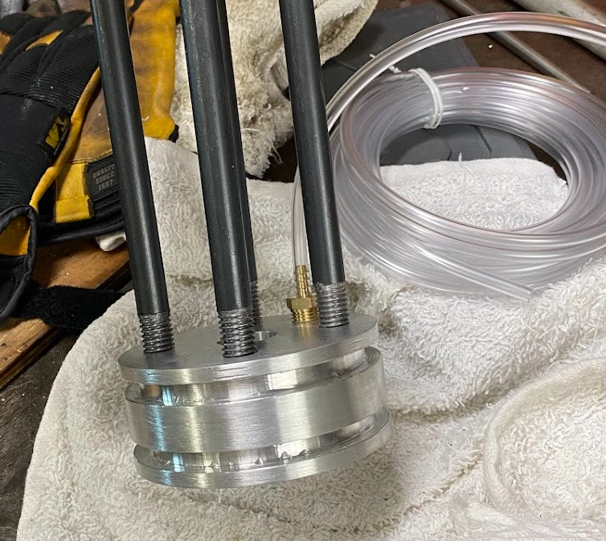
Design and Build of Old Design

Slide 12
Problems with Old Design
Nothing disqualifying, but there are some confounding issues with this prototype
- Space aligned with the piston is most important, and limited by a key problem.
- Many members of the frame need to be large to transfer load, and
- Lots of sensors used that may not be needed
- Complicated to prototype!

Slide 13
The Piston Problem
2x travel distance required for piston to travel due to need for a piston rod
Travel is cut down further from available space due to required width of pistons, structure, hatch, etc.
Sets hard limit on machine size.

Slide 14
Piston Rod Volume Allowance
In closed chamber, the rod takes up space as the piston extends
To handle this, chamber diameter needs to change

Slide 15
Moving Past a Linear Actuator
The core design seems promising, but it got to be complicated making the hardware.
I could have built the design using linear actuators and simplified things, but it would be great to use space more efficiently, and simplify the design.
How else can this pressure be achieved?
Hydraulics, pneumatics, etc.

Slide 16
Free Floating Piston Design
In the old design, the wash chamber/machine itself was the pump. Now the pump is moved outside, and the piston is moved by fluid pressure.
No piston rod, no volume compensation needed.
No unused space for a piston rod.
Fewer locations for a leak to the environment to appear.
Fewer Sensors. Only pressure required, optional means of determining piston position if desired.

Slide 17
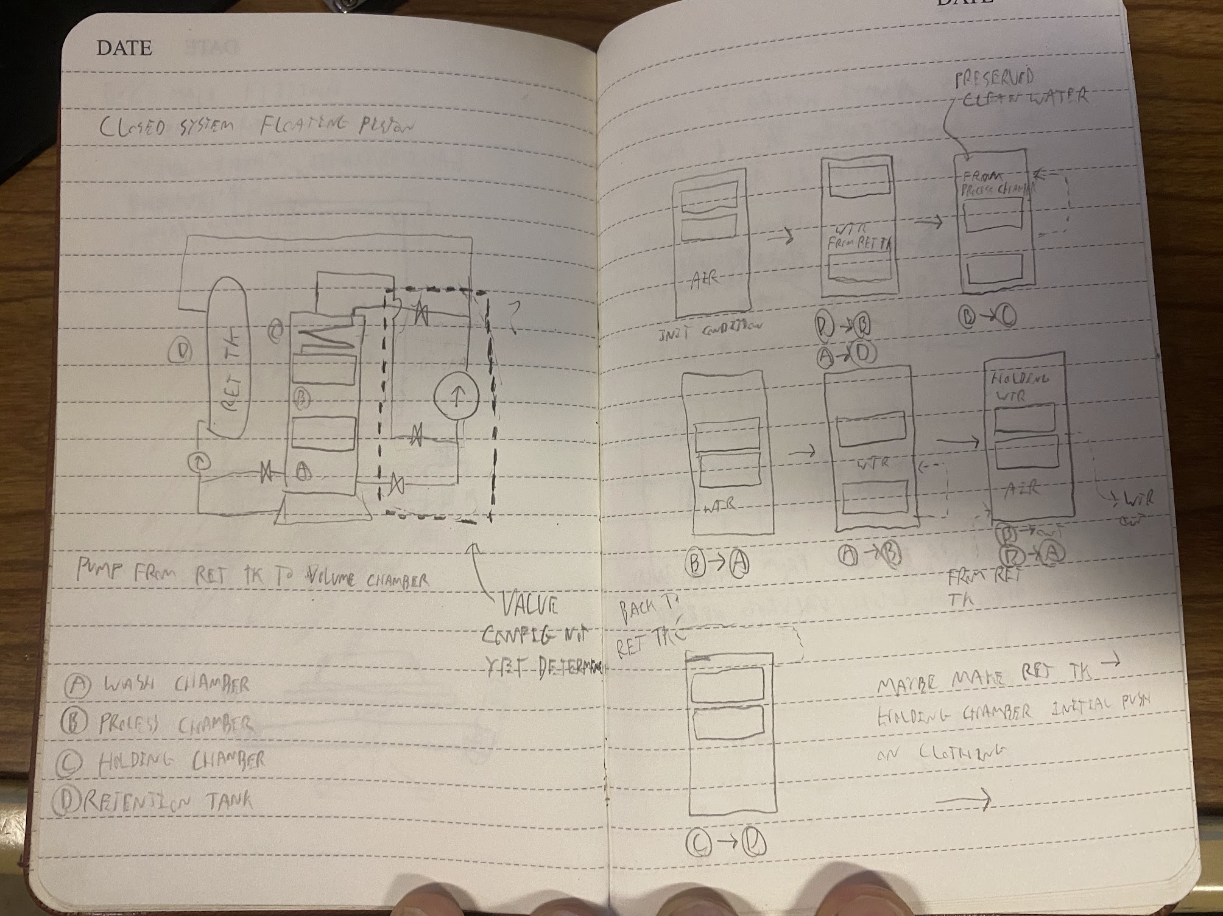
Rudimentary Operation Diagram

Slide 18
Disadvantage of Approach
Now we are dealing with fluid pressure, and the possibility of a leak into the environment.
That said, this may not be as big of an issue…

Slide 19
Required fluid pressure for needed compression is less than that of residential water.
Wash chamber is a fixed size, a leak will result in a detectable loss in pressure.
Leaks are only limited to the volume of water used during a wash cycle.
There are systems that can be implemented to detect bad sealing before a wash cycle, and detect a leak during the wash process.

Slide 20
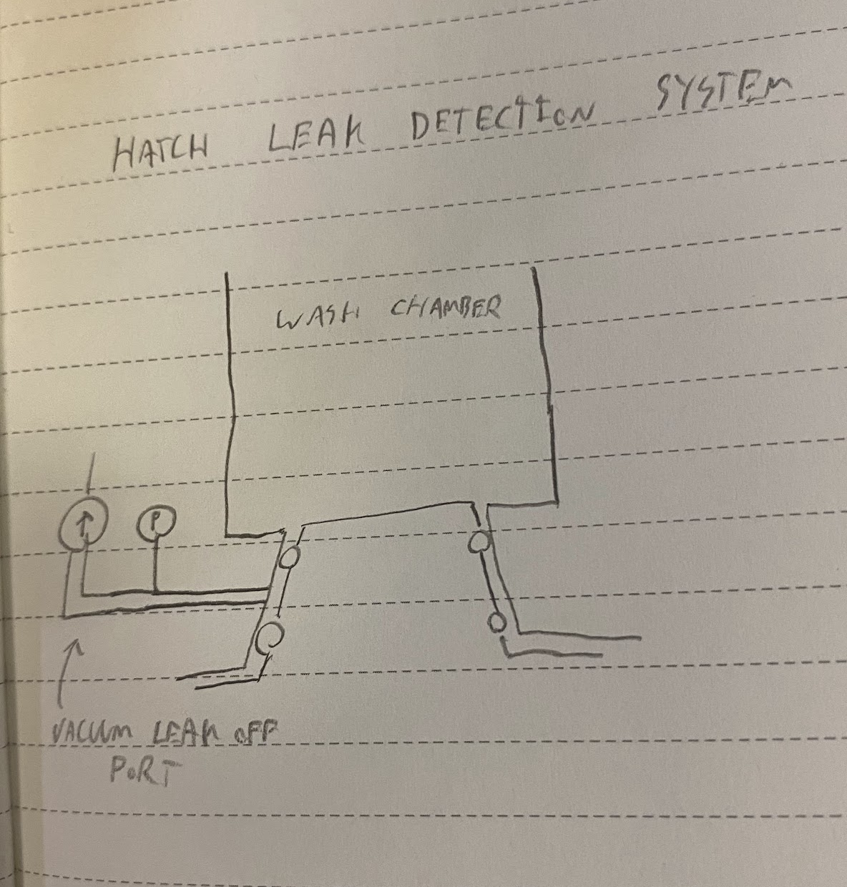
Hatch Leak-off Ports
Suction taken on hatch seals prior to process.
If pressure isn’t held, process wont start.
If pressure drops during process, process aborted, water will leak into leak off port instead of environment.

Slide 21
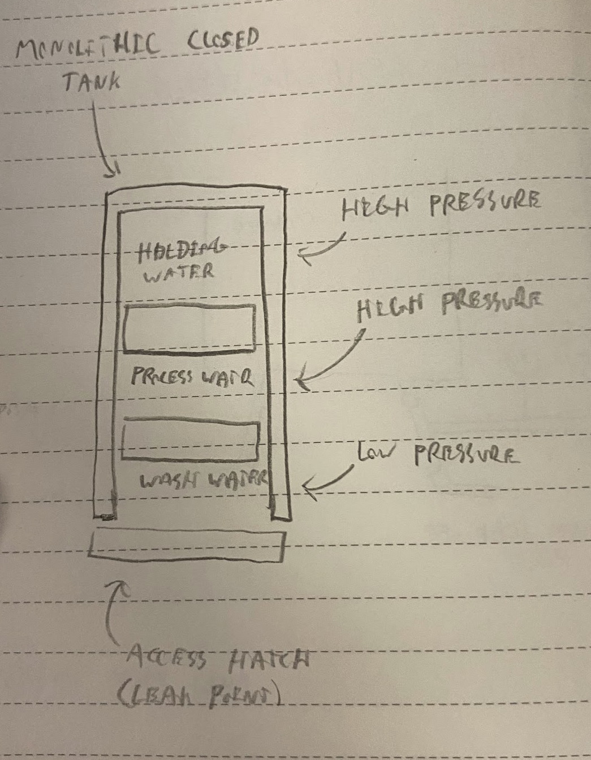
Pressure-Leak Contingency Diagram
High fluid pressure is separated by multiple stages of seals inherently from likely leak points
(the hatch mainly)
And can be detected as an abnormal pressure reading during the process.

Slide 22
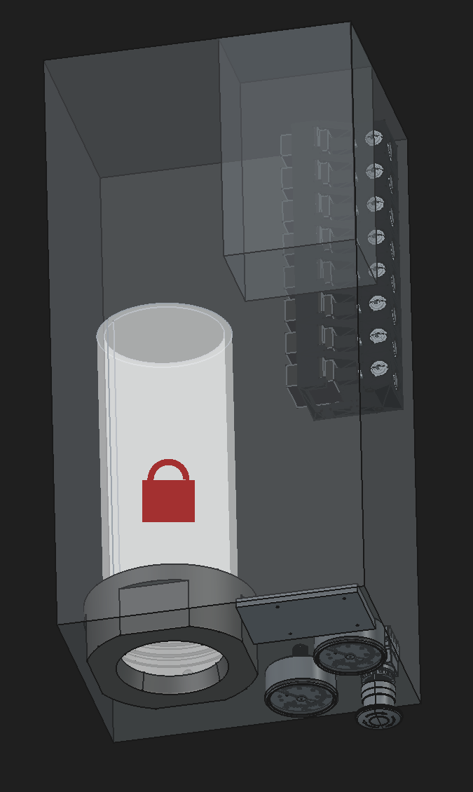
CAD Model Mock-Up
Since the design doesn’t require any specific placement of items, the design of the frame is less important.
This picture just gives a sense of size for the components. Everything can be placed wherever needed, and connected by pipes/tubing.

Slide 23
At the end of the day
This will be easier for me to manufacture.
Fewer custom parts. Can rely more on off the shelf components. Will be MUCH easier to make edits to the hardware, disassemble and fix, etc.

Slide 24
Thank you!
Questions?

